Slide 1



Pet Training School Management System
This comprehensive management system is designed to streamline administrative operations for pet training schools. Our goal is to automate student registration, course enrollment, and overall school management processes, creating a seamless experience for administrators, teachers, and students.
User Registration & Authentication
Secure and efficient sign-up and login for all user roles.
Course Selection & Enrollment
Easy browsing and direct enrollment into various training courses.
Student & Course Management
Centralized tools for tracking student progress and course details.
Role-Based Access Control
Tailored functionalities for admins, teachers, and students.

Slide 2
Technical Architecture
Our system is built on a robust and modern technology stack to ensure performance, scalability, and an intuitive user experience. This layered approach provides both stability and flexibility for future enhancements.
Backend: Spring Boot
Frontend: Java Swing
Database: MySQL
Robust framework for powerful server-side logic and API management.
Responsive desktop GUI application for seamless interaction.
Reliable data persistence and efficient retrieval for all school records.
Key Dependencies
FlatLaf: Modern UI theme library for an enhanced visual appeal.
Lombok: Automates boilerplate code for cleaner, more readable Java.
Spring Web: Facilitates seamless frontend-backend connectivity.
Spring Data JPA: Simplifies database operations with automatic CRUD functions.
MySQL Driver: Essential for efficient database connection management.

Slide 3
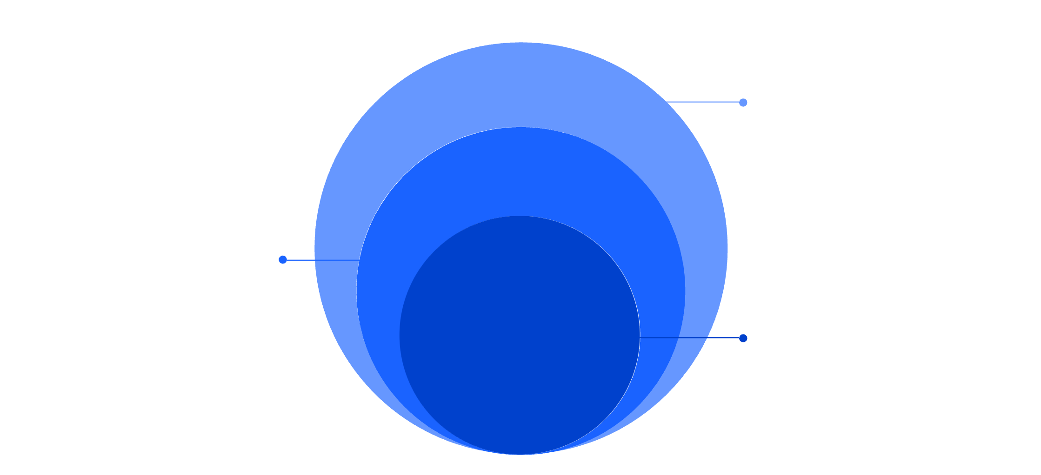
MVC Architecture Design
The system adheres to the Model-View-Controller (MVC) pattern, ensuring a clear separation of concerns, improved modularity, and easier maintenance. This structured approach optimizes development and future scalability.
View
Renders GUI and captures user input
Controller
Processes requests and coordinates services
Model
Holds data and repository logic
1
2
3
View Layer
Controller Layer
Model Layer
Dedicated to user interface components and display (GUI classes).
Processes business logic and orchestrates interactions (Service classes).
Manages data access and persistence (Repository classes).
This modular design enhances developer collaboration, facilitates easier debugging, and ensures the application remains robust as new features are integrated.

Slide 4
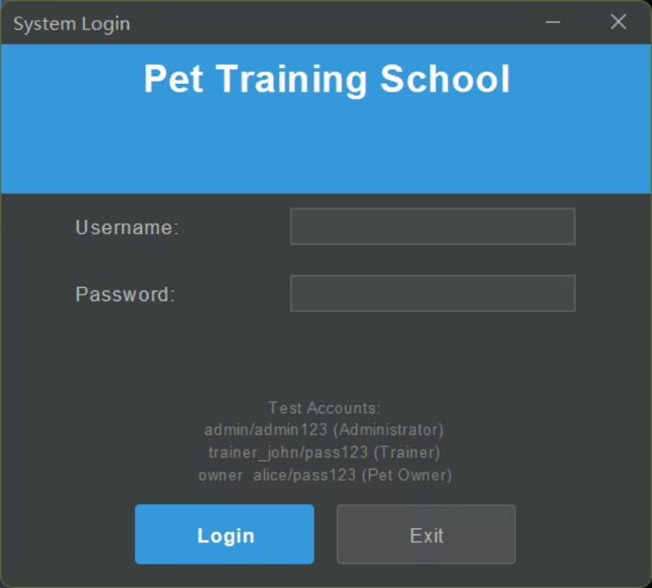
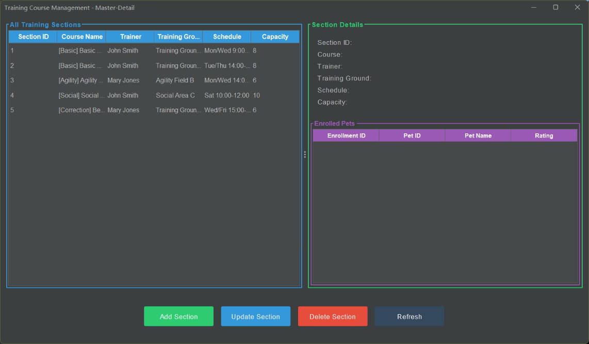
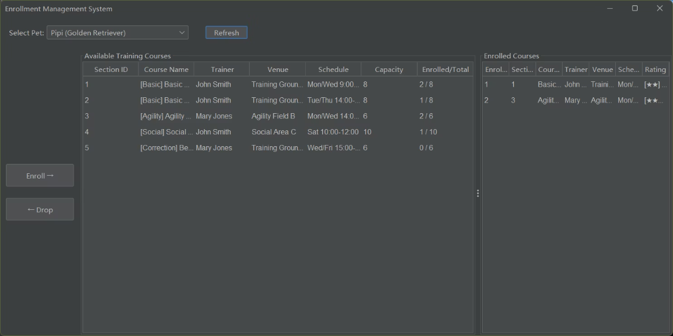
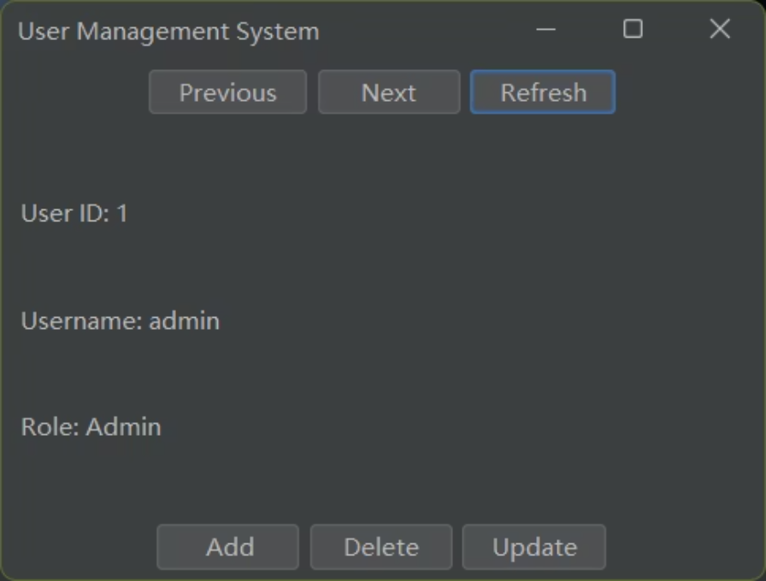
Key Features in Action
Experience the core functionalities of our Pet Training School Management System. These interfaces are designed for clarity and ease of use, ensuring a smooth experience for all stakeholders.
User Login & Authentication
Course Browsing & Selection
A secure and straightforward interface for users to access their accounts.
Easily explore and select from a variety of available pet training courses.
Enrollment Management Dashboard
Admin Control Panel
Centralized overview for administrators to manage student enrollments and progress.
Comprehensive tools for administrators to oversee and configure system settings.

